Slide 1
Group Meeting Update 6/9-2023
Calibration of Readout
Qmath – Quantum Learning Theory
Work has been done on readout
Optimization
Photon Calibration
Efficiency Extraction

Slide 2
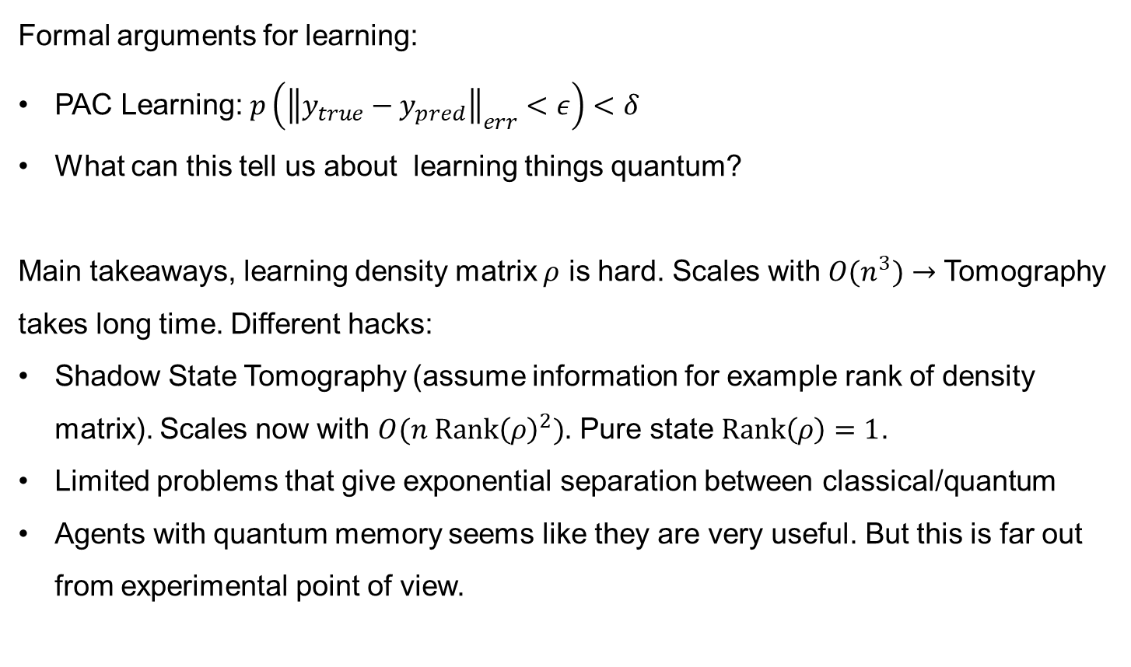
Quantum Learning Theory
Group Meeting 6/9-2023
Formal arguments for learning:
PAC Learning: $p\left({\left\|y_{true}−y_{pred}\right\|}_{err}<ε\right)<δ$
What can this tell us about learning things quantum?
Main takeaways, learning density matrix $ρ$ is hard. Scales with $O(n^{3})$ $→$ Tomography takes long time. Different hacks:
Shadow State Tomography (assume information for example rank of density matrix). Scales now with $O(n Rank{\left(ρ\right)}^{2})$. Pure state $Rank\left(ρ\right)=1$.
Limited problems that give exponential separation between classical/quantum
Agents with quantum memory seems like they are very useful. But this is far out from experimental point of view.
Conclusion
Concretely, the learning outcome was maybe not aligned with my thesis.
However, it was healthy to see what quantum algorithms and learning look like to mathematicians.

Slide 3

Lower bounds and upper bounds.
Lecturers:
Jonas Helsen
Hsin-Yuan Huang
Yihui Quek
Ingo Roth
Ronald de Wolf
Laura Mancinska
Tim Möbus
Quek: Information-theoretic lower bounds for learning
Tomography (classical algorithm) scales exponentially with system size for a given precision.
Huang: discuss quantum advantage over classical.
In the past there have only been proven quadratically advantage of a quantum computer.
He proves exponential advantage when simulating properties of a quantum system (observables).
Takeaway: Quantum systems simulate quantum systems exponentially better than a classical computer on some tasks.
Notes:
Yihui Quek: information-theoretic lower bounds for learning. (knowing the boundaries of what can be done on a QC) - The tomography had a lower bound where the number of measurements for a given precision scales exponentially with the system size
- Meaning you can use tomography (using a classical algorithm) on a few qubits, but not if we go to bigger systems. Because you need to do an experiment on a quantum computer and read it out, then handle the data on a classical computer in order to learn the quantum state.
Huang also discuss that quantum computers advantage over the classical. So far there have only been proven quadratically advantage of a quantum computer. He proves that a quantum computer can learn from exponentially fewer experiments than those required in conventional experiments on a classical computer. But it depends of course on the task (in this case it is learning a property of a quantum system (observable )).
(He even did an experiment).
For a classical computer to learn a quantum state, you need to do experiments and look at the outcome, process the information and that takes exponentially more time than a quantum computer, because a quantum computer can do it efficiently.
Instead of doing tomography on a classical computer, you want to use a quantum system (ex. Quantum sensors) and get the information directly in quantum-computer memories where it can be processed.
- Quantum systems simulate quantum systems better than a classical computer.

Slide 4
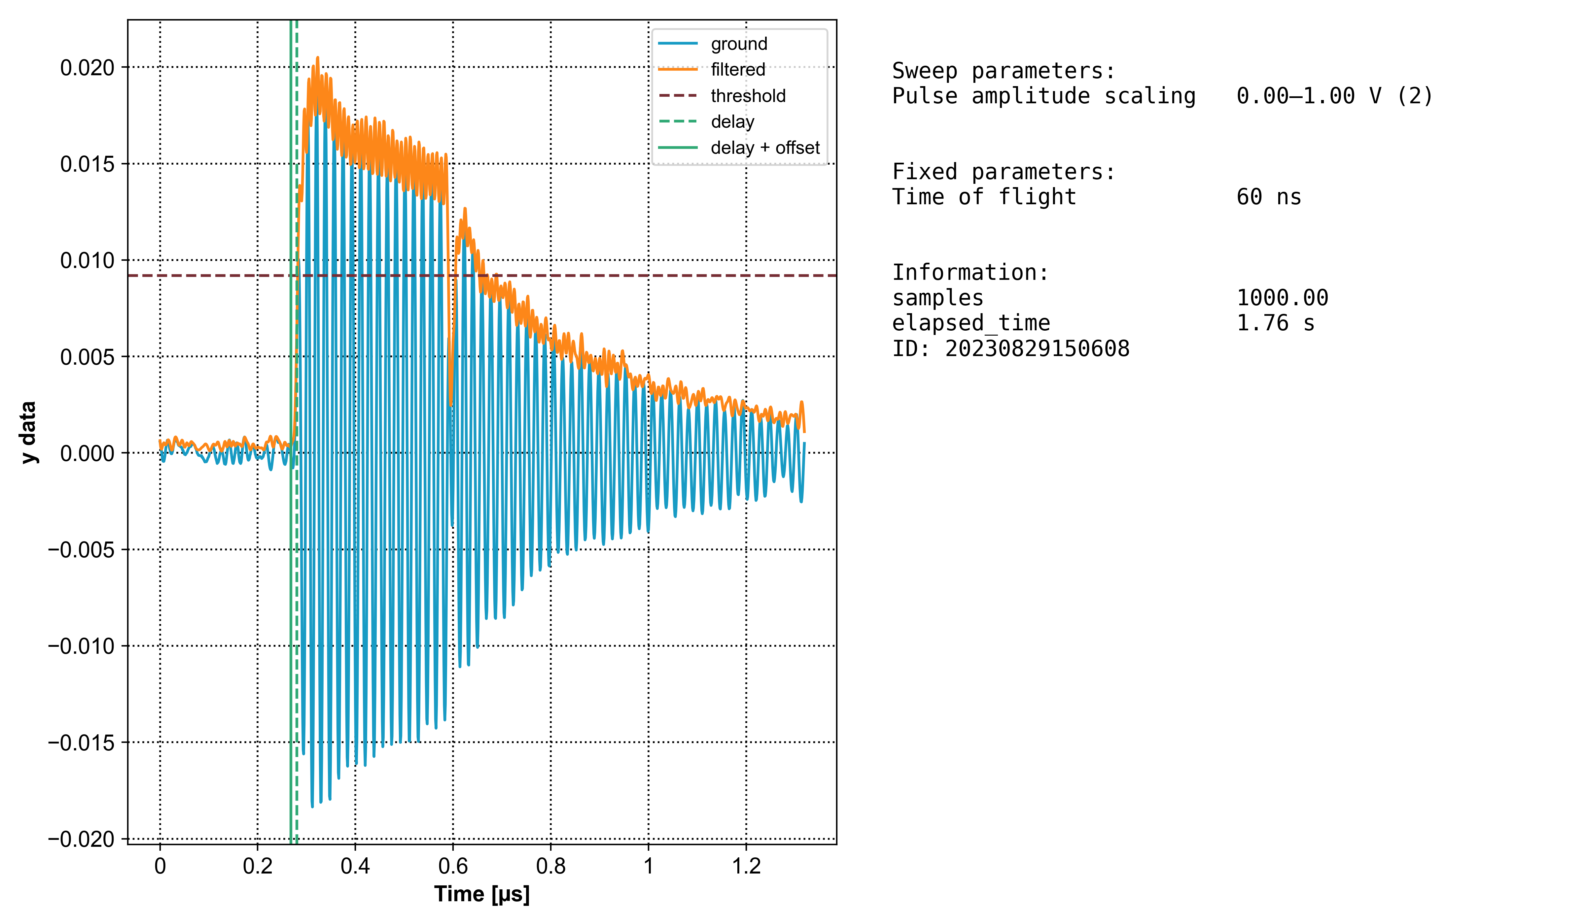
Readout
Calibration of Readout
Pulse Alterations
Optimization
Photon Calibration
Efficiency Extraction
Before:
After:
Motivation
Signal in Resonator
I looked through the readout strategies with Malthe:
Problem/motivations:
A lot of decay in readout
Time of flight was set 200-300 ns after information peaked.
Photons left in the resonator when doing active reset
We would like higher fidelity

Slide 5
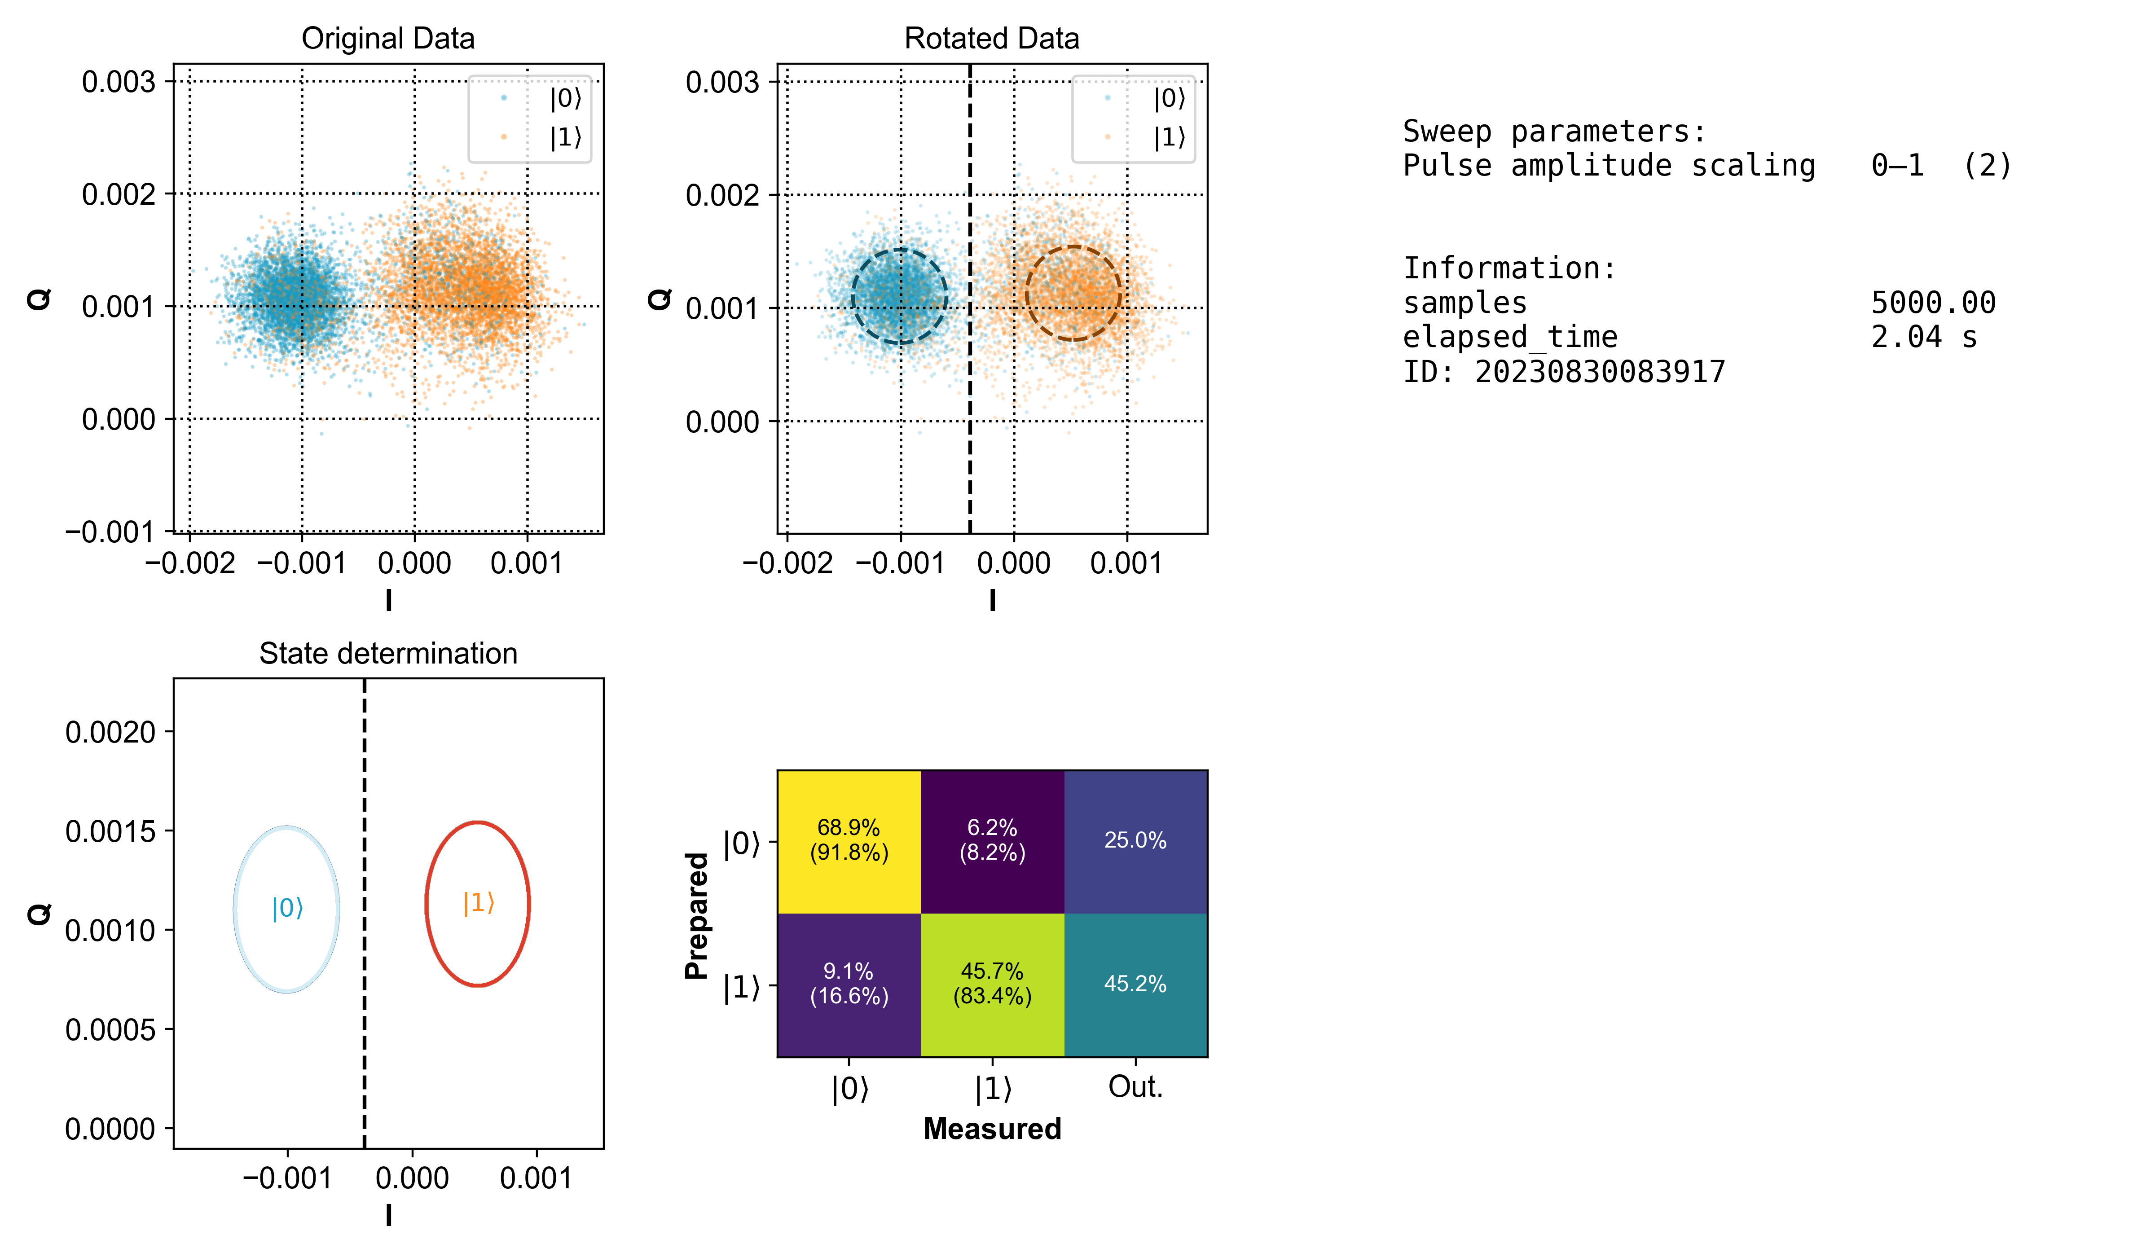
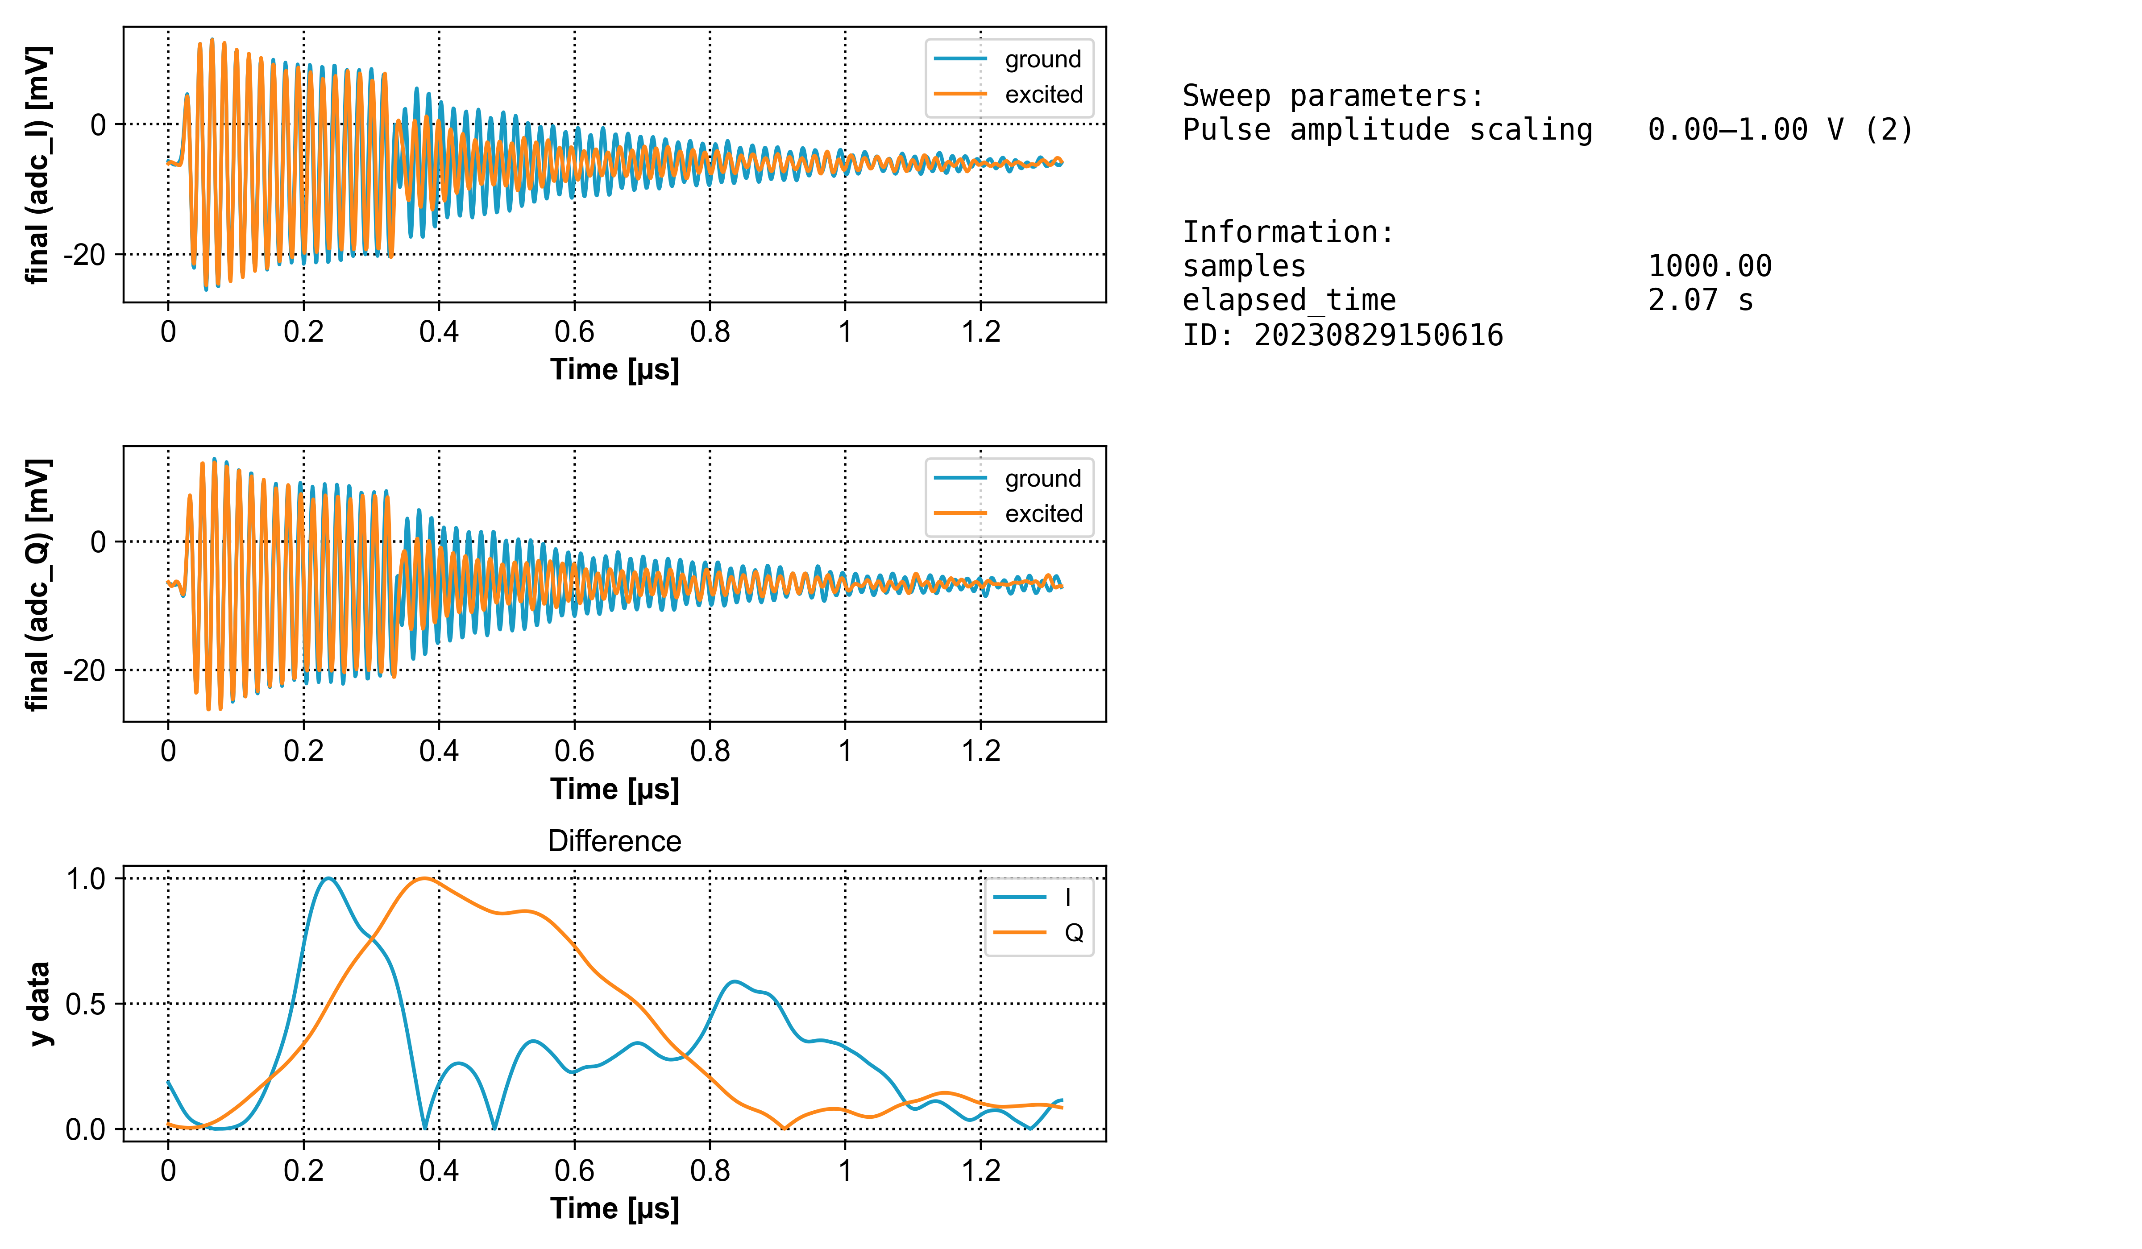
Readout
Calibration of Readout
Matched Filter

Slide 6
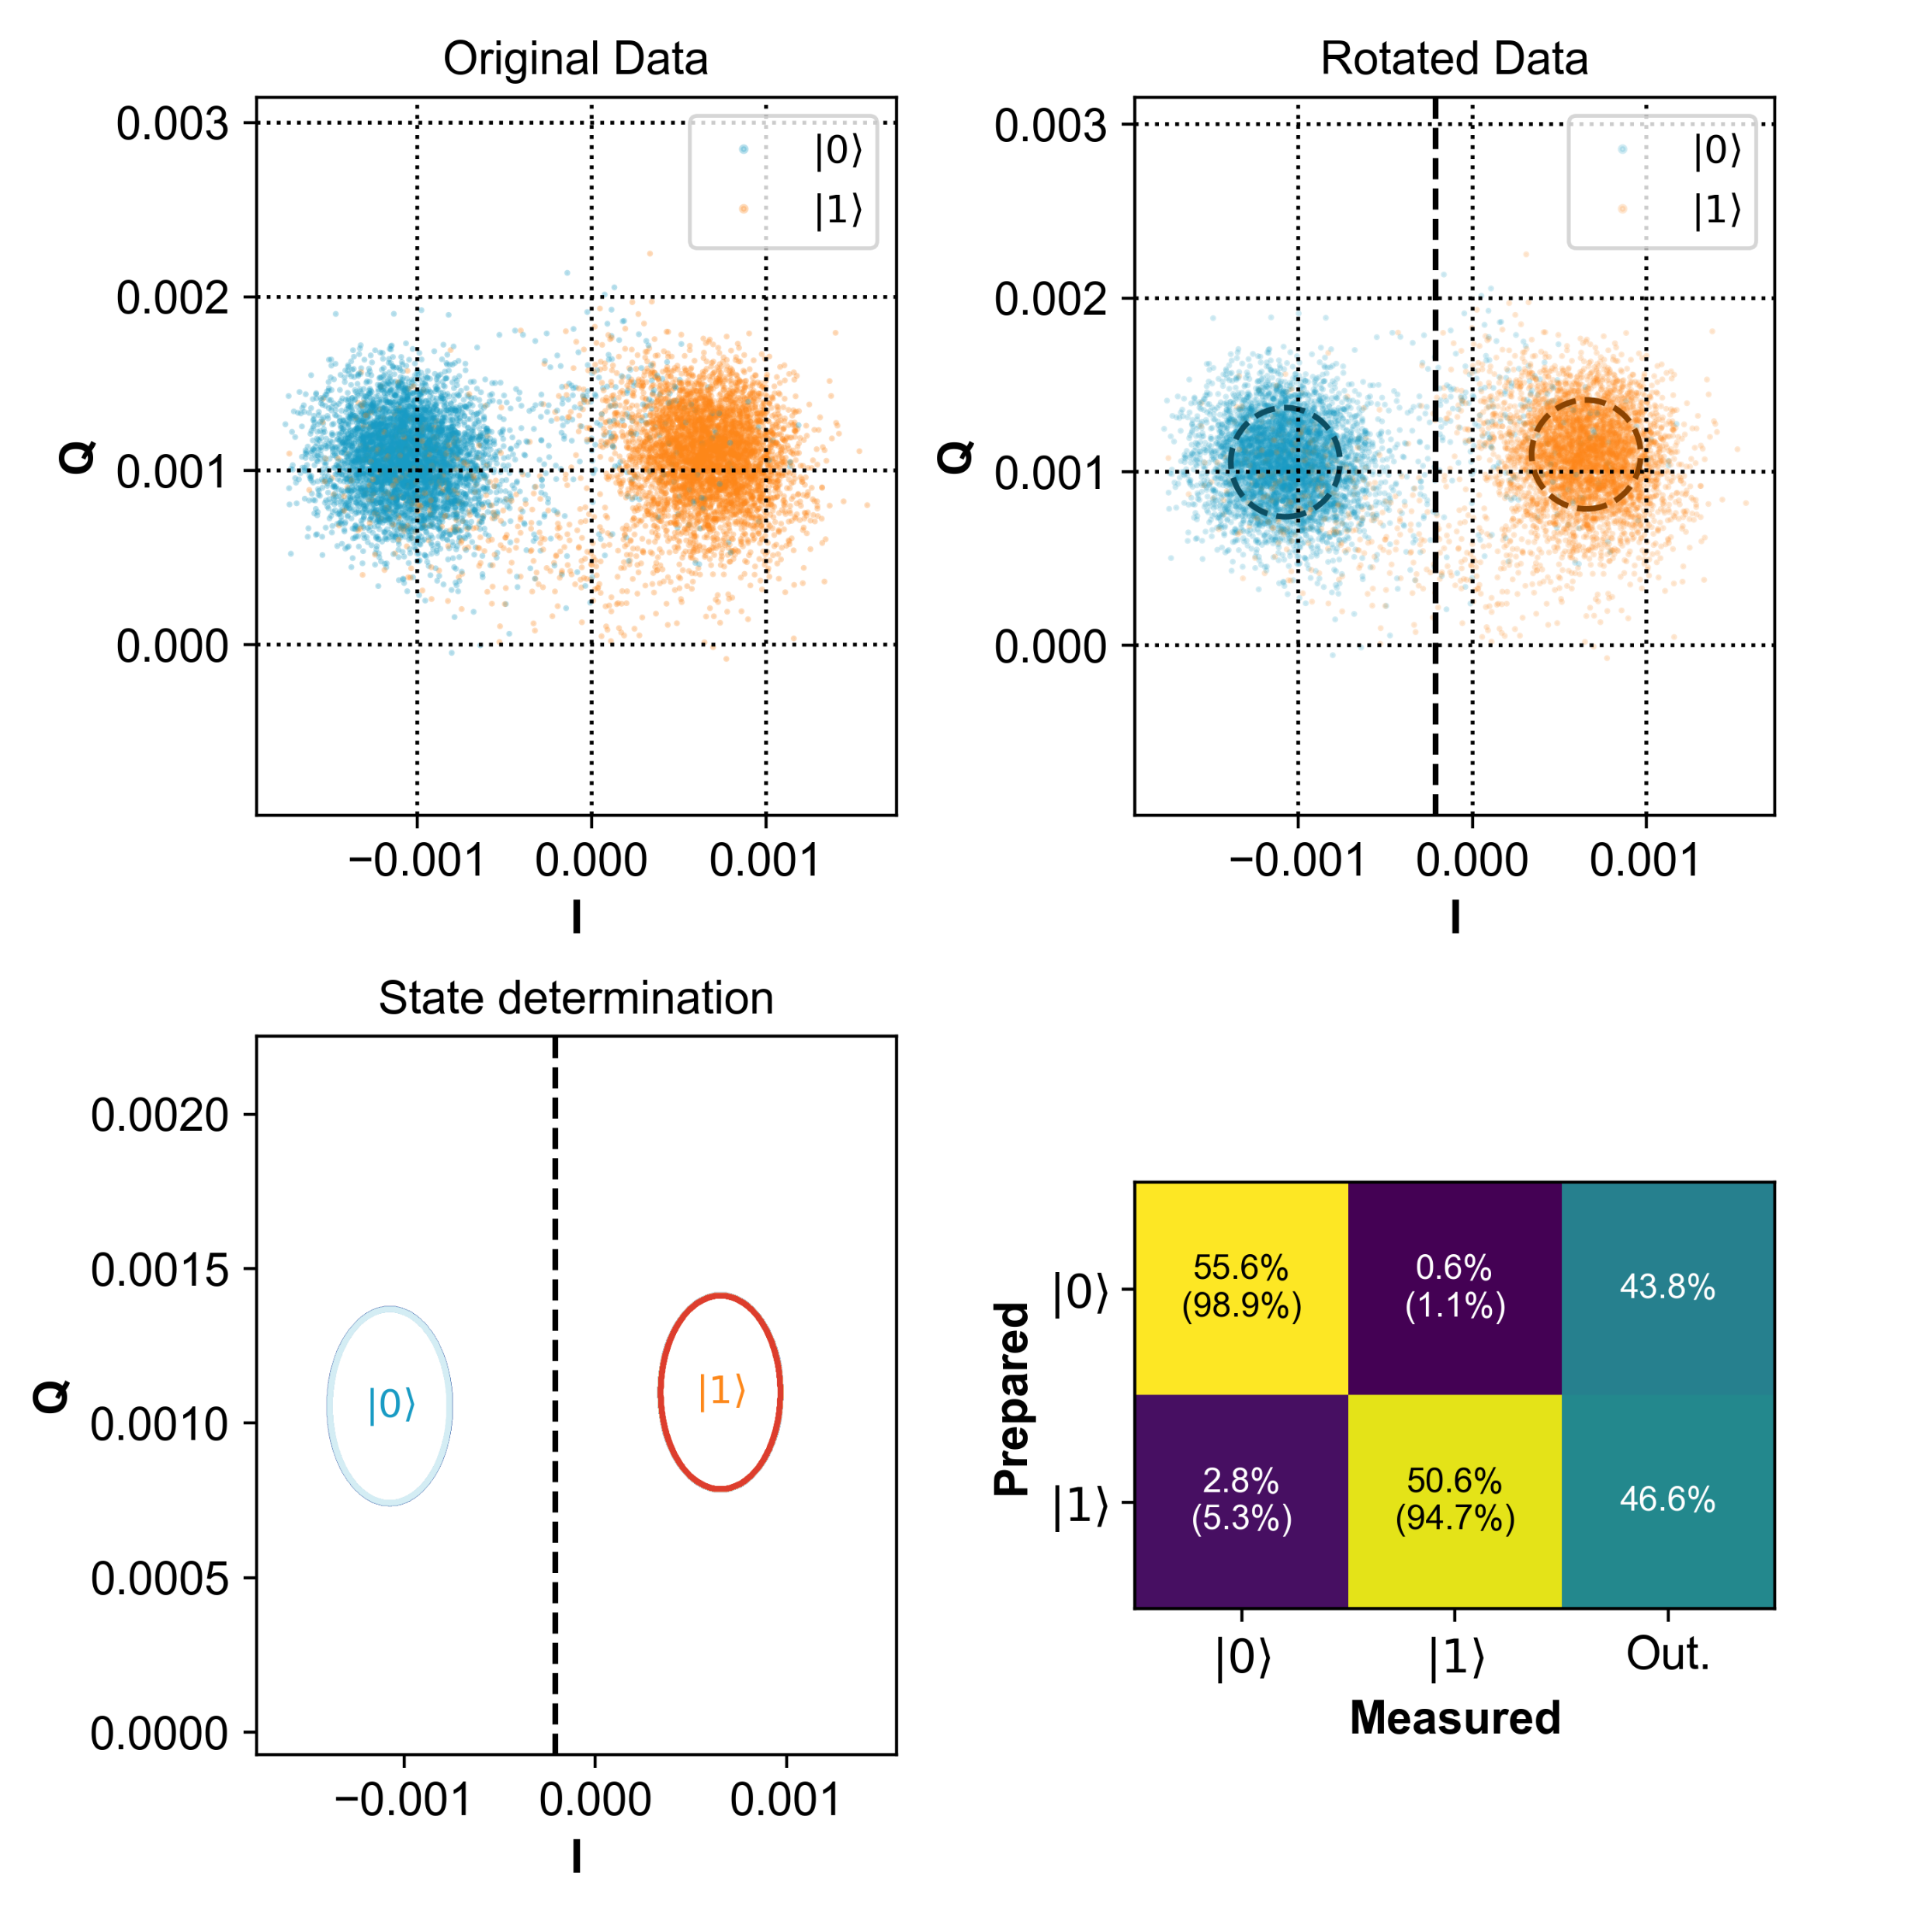
Readout
Calibration of Readout
Matched Filter

Slide 7
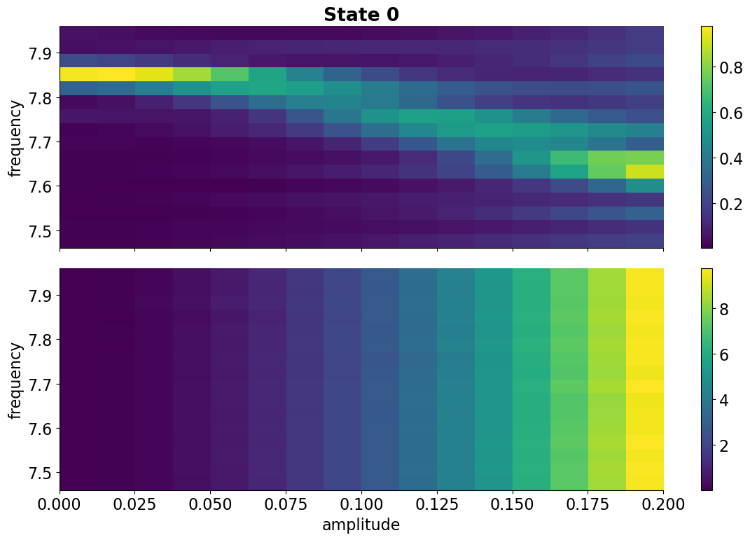
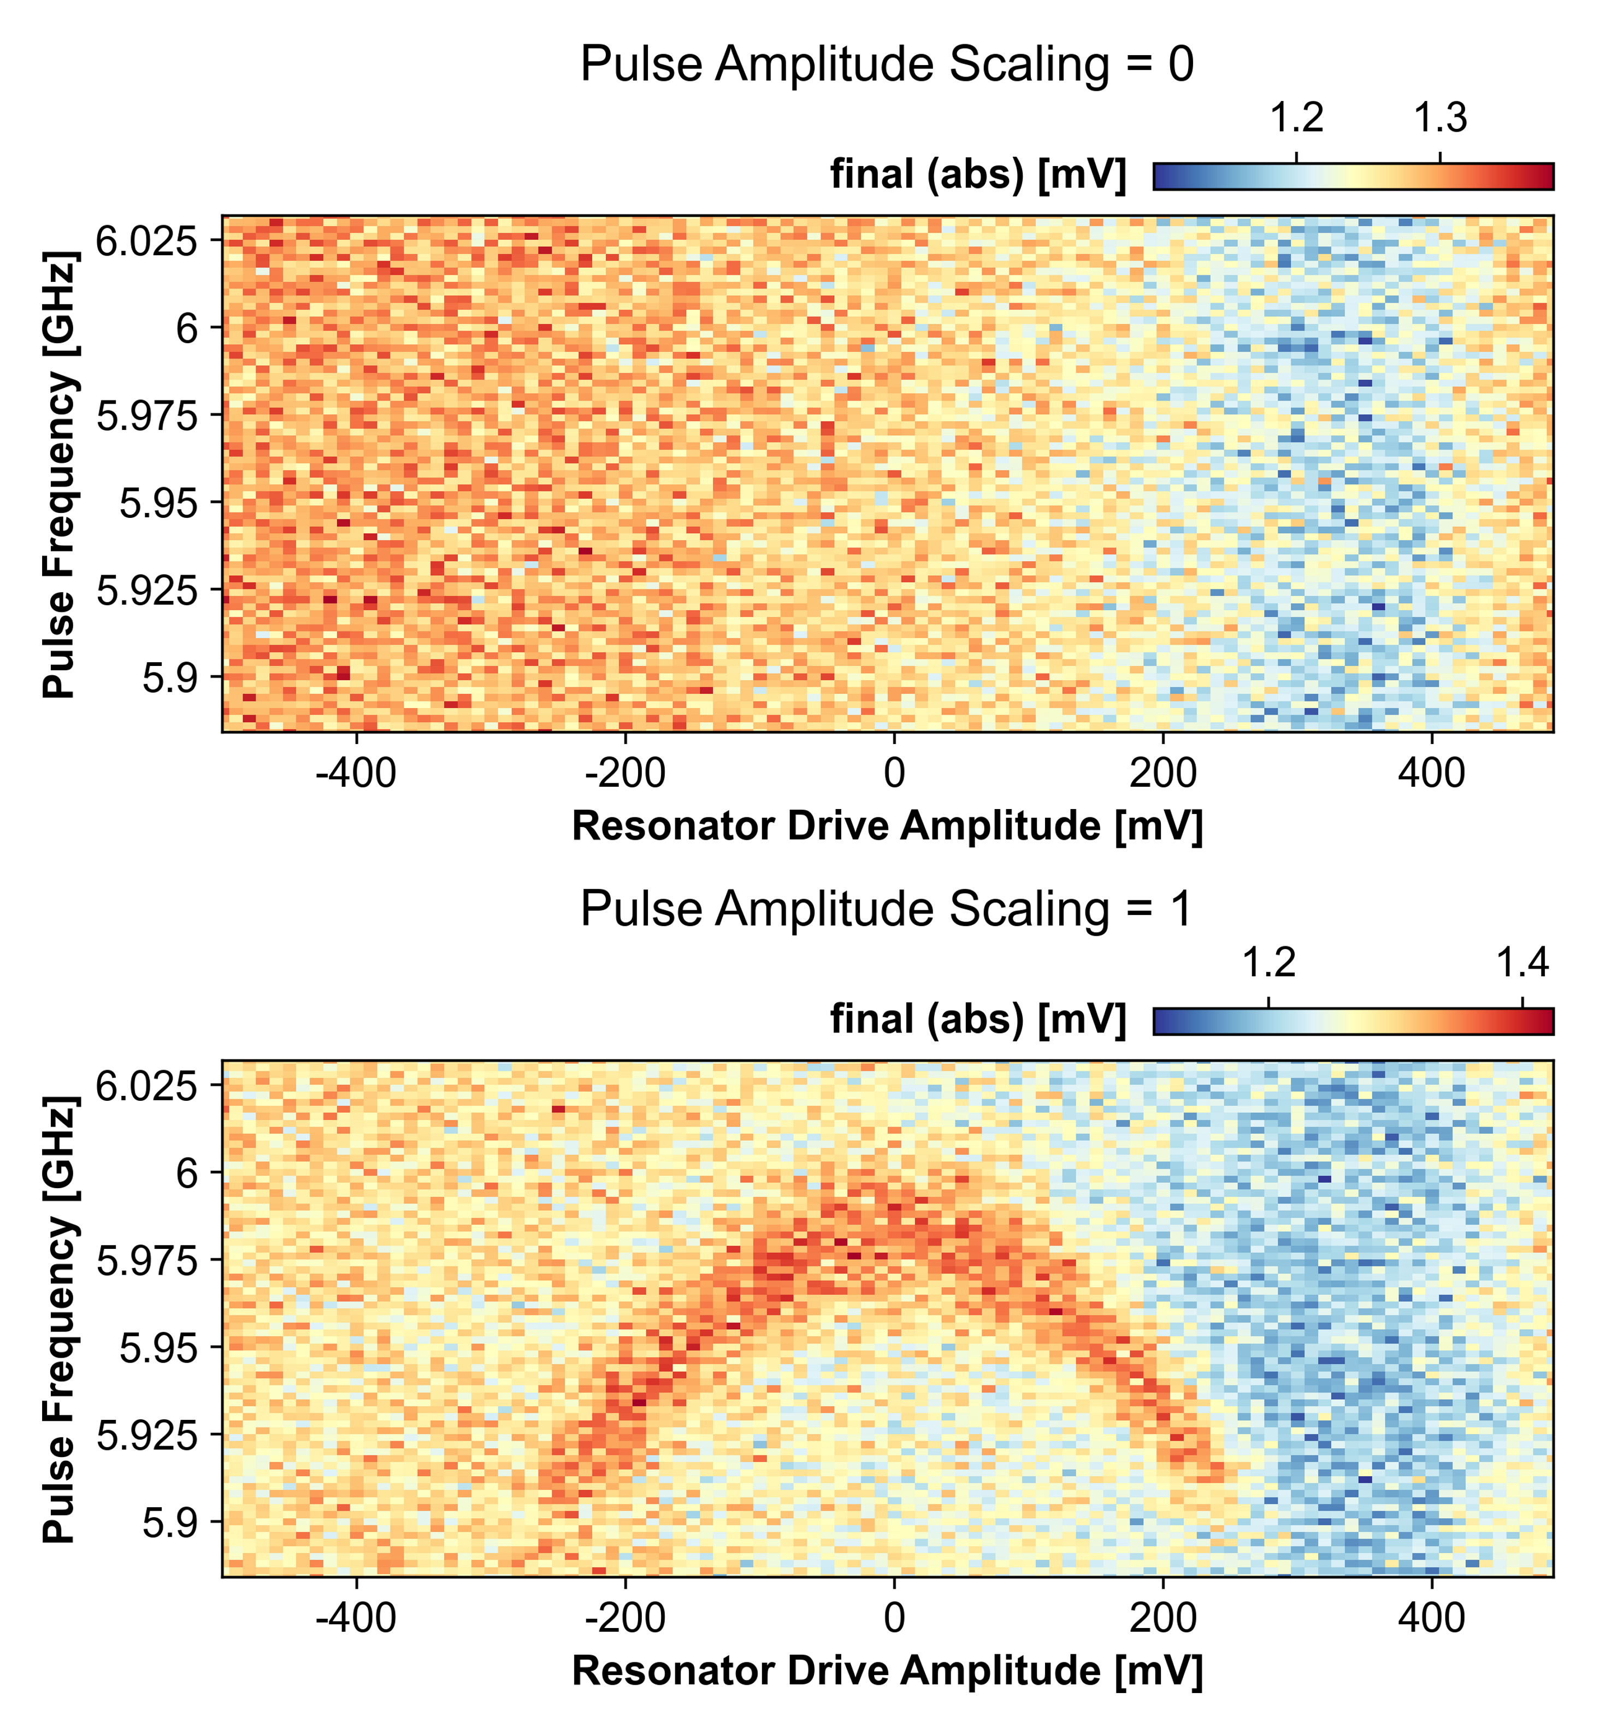
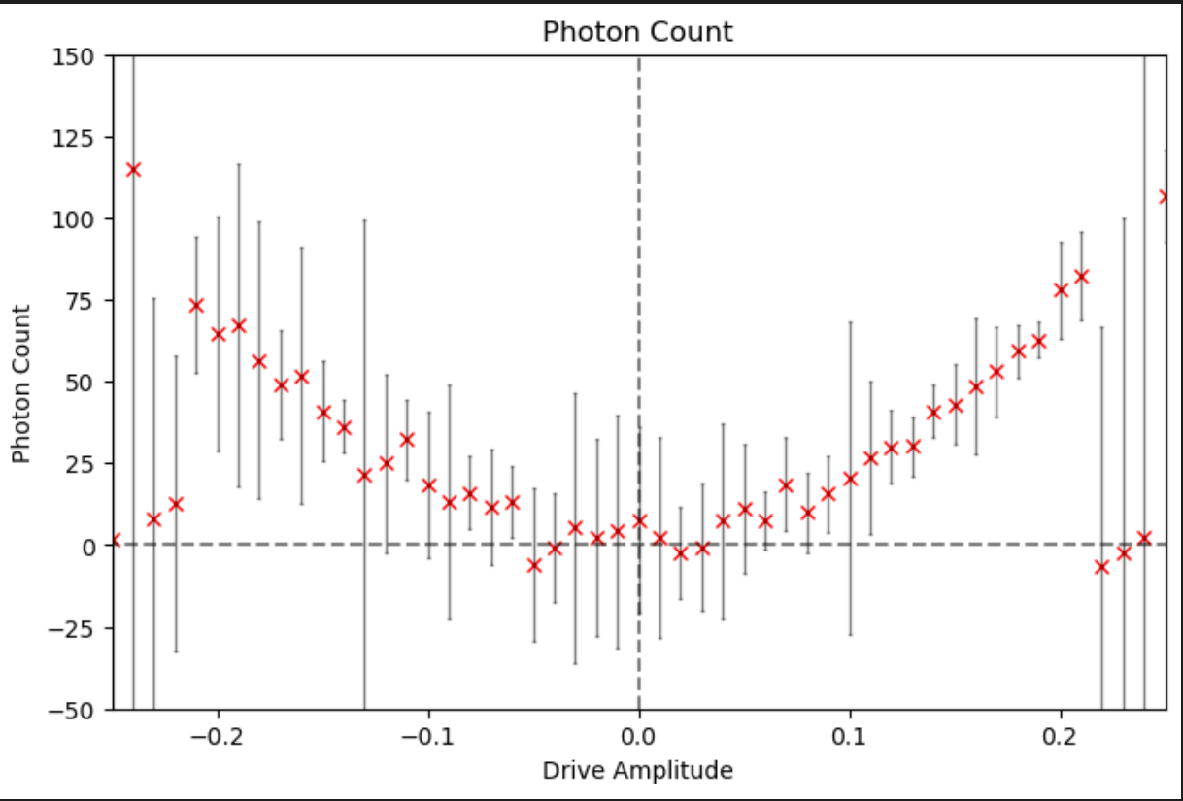
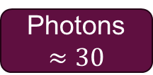
Readout
Calibration of Readout
Optimization
Photon Calibration
Efficiency Extraction
Simulation
Experiment
Photon Count
Photons $≈30$

Slide 8
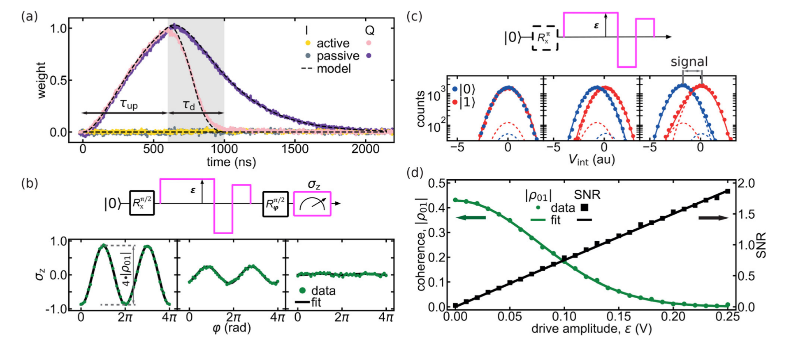
Readout
Calibration of Readout
Optimization
Photon Calibration
Efficiency Extraction
C. C. Bultink et. al. – 2017 - Delft Group

Slide 9
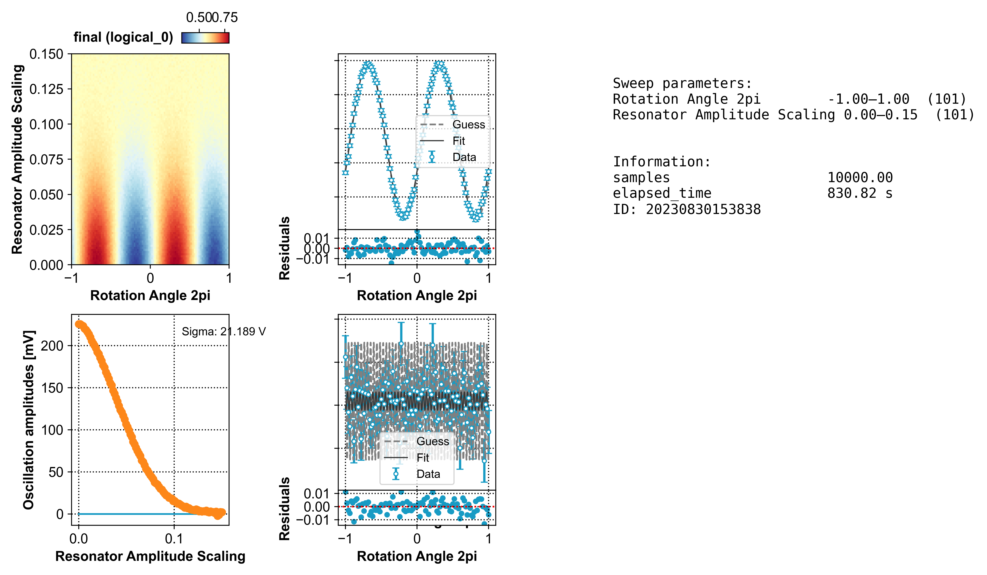
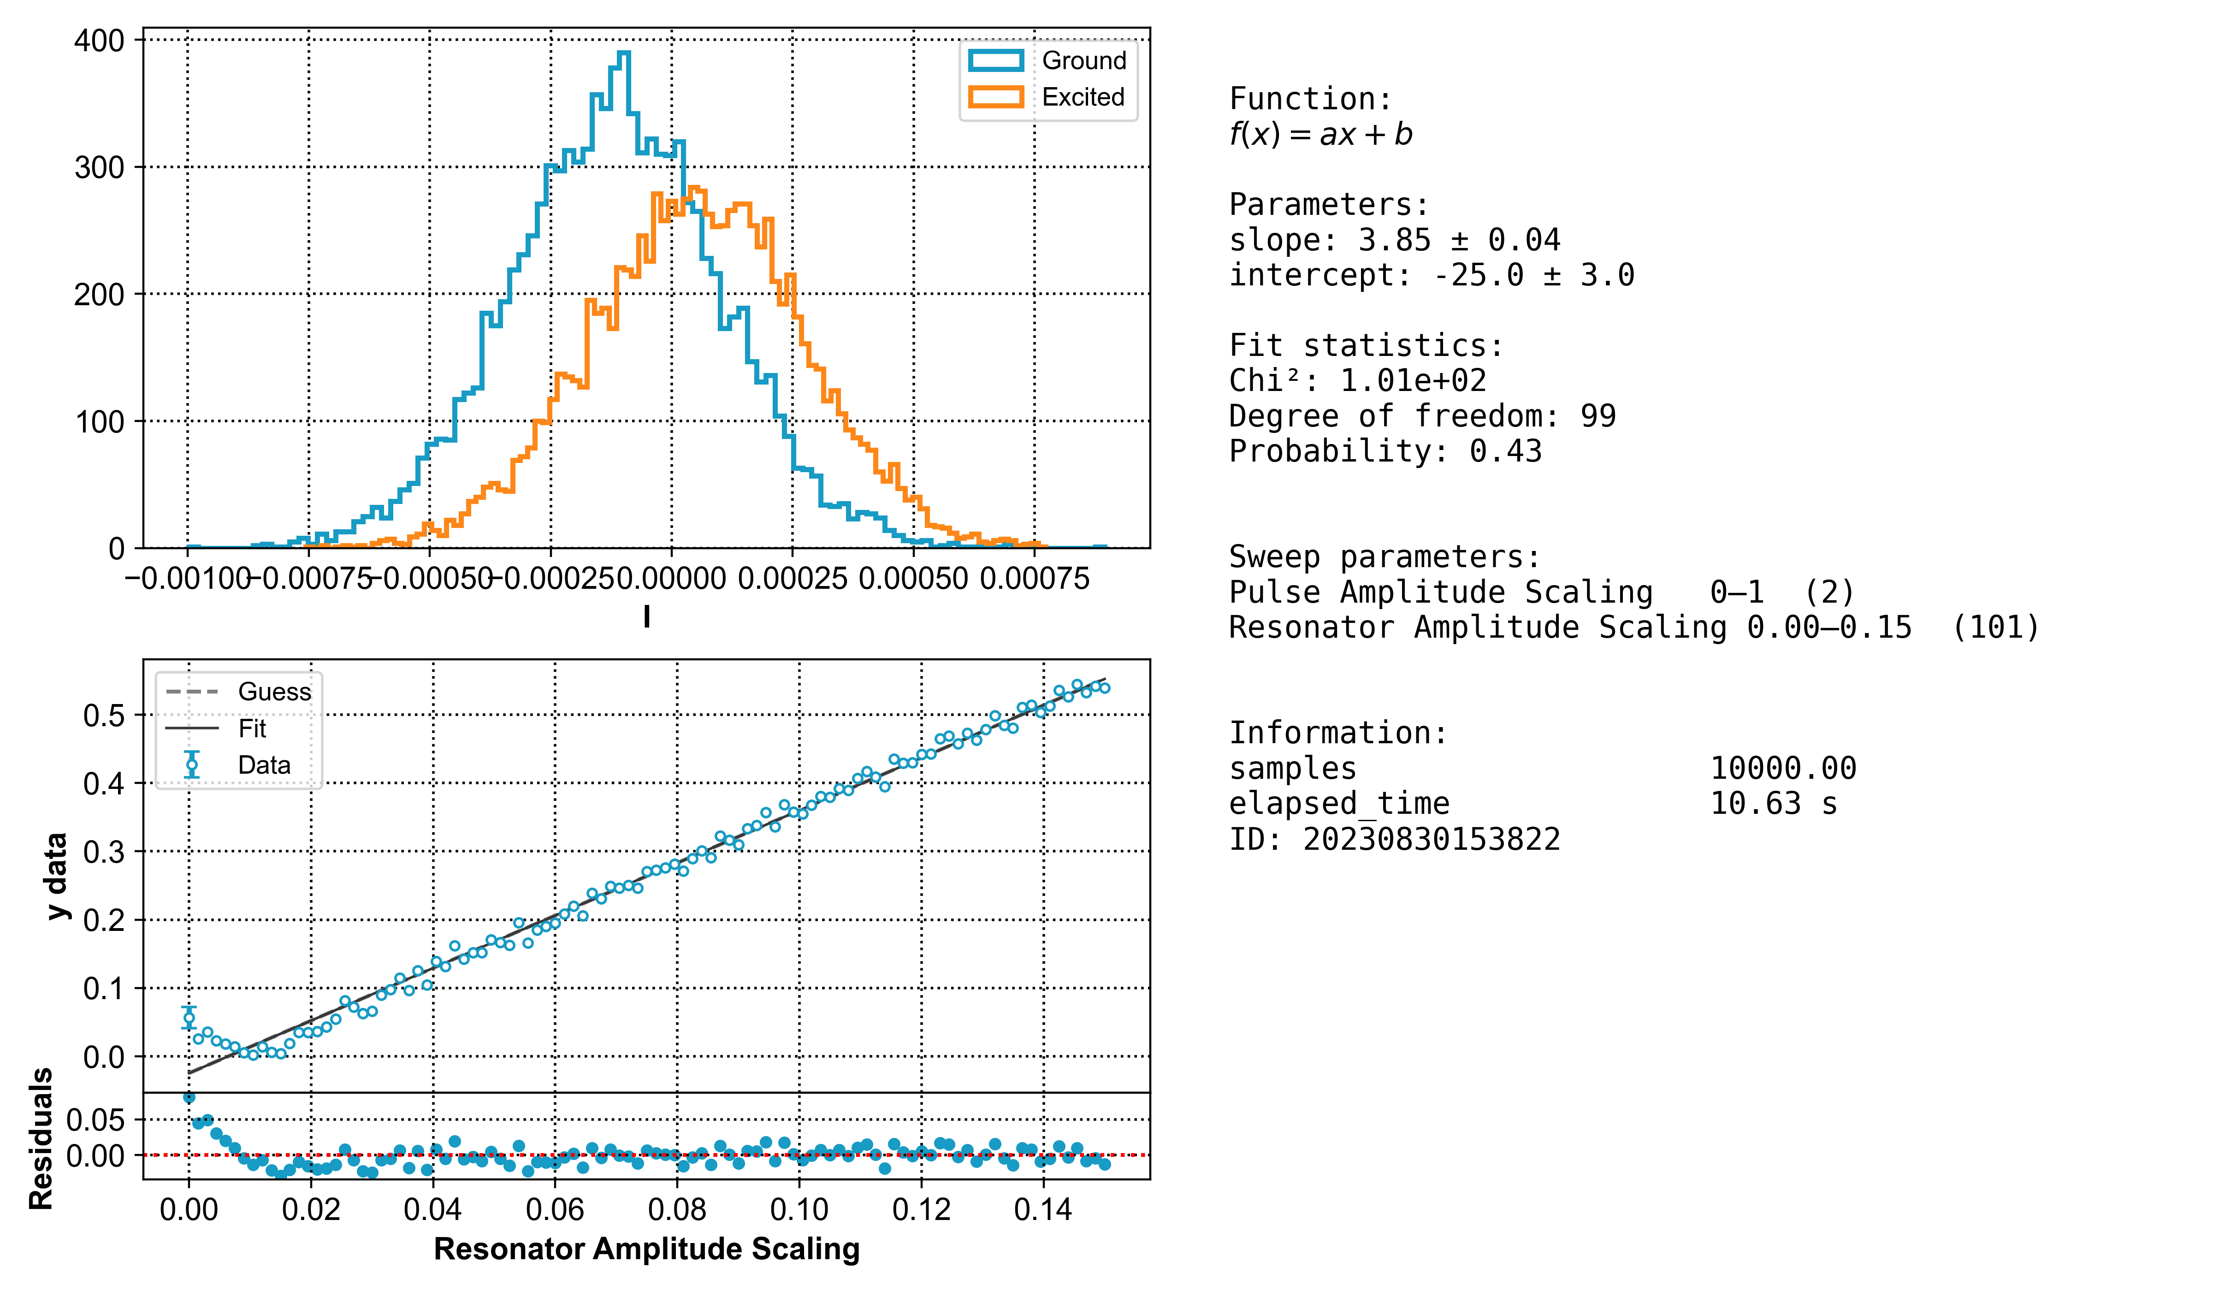
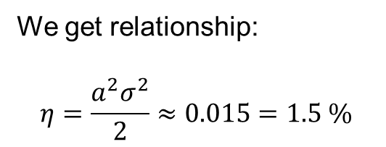
Readout
Calibration of Readout
Optimization
Photon Calibration
Efficiency Extraction
We get relationship:
$$η=\frac{a^{2}σ^{2}}{2}≈0.015=1.5 \%$$

Slide 10
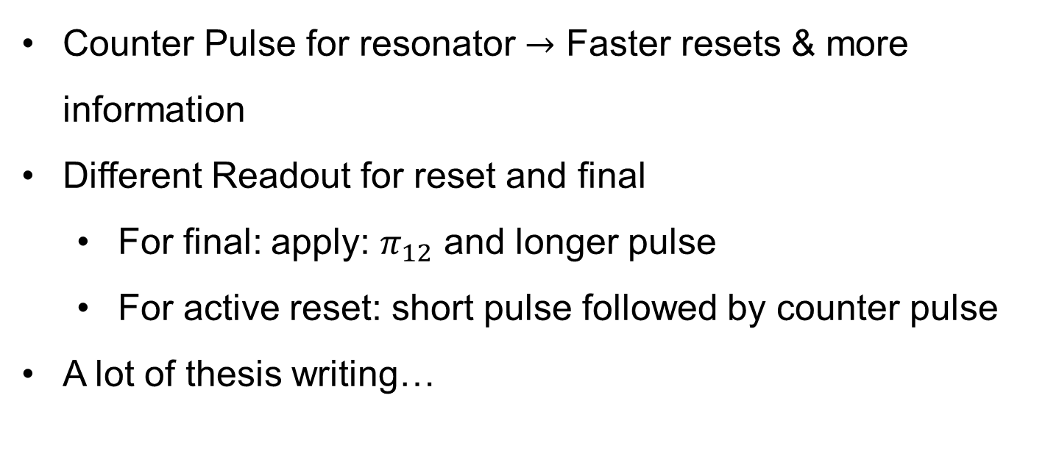
Next-up
Calibration of Readout
Counter Pulse for resonator $→$ Faster resets & more information
Different Readout for reset and final
For final: apply: $π_{12}$ and longer pulse
For active reset: short pulse followed by counter pulse
A lot of thesis writing…

